Slide 2
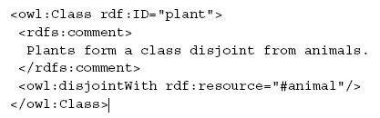
Disjoint
Animal ∏ plant = ⊥
Or
Plant ⊑ ¬ animal

Slide 3

subsumtion
Tree ⊑ plant

Slide 4
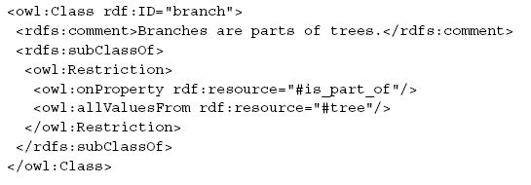
All values from
Branch ⊑ ∀Is_part_of.tree

Slide 5
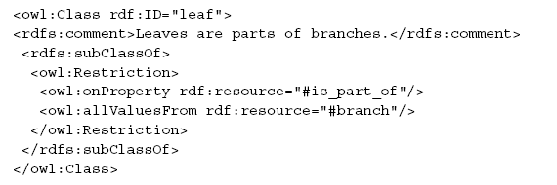
All values from
leaf ⊑ ∀Is_part_of.branch

Slide 6

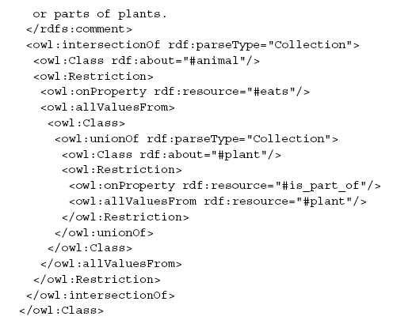
All values from, role union
Herbivors=animals ∏ ∀eats.(plant U ∃is_part_of.plant )

Slide 7
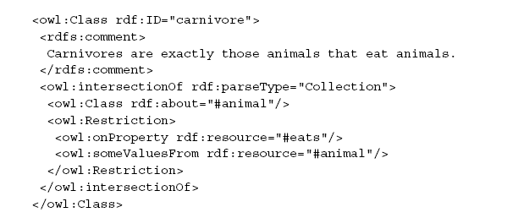
Some values from
Carnivore = animal ∏ ∃ eats.animal

Slide 8
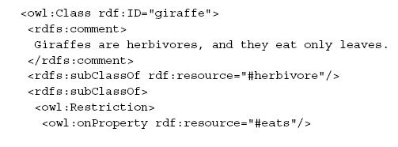

giraffe = herbivores ∏ ∀ eats.leaf

Slide 9
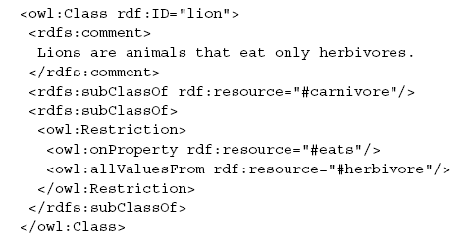
Lion=carnivore ∏ ∀ eats.herbivore

Slide 10
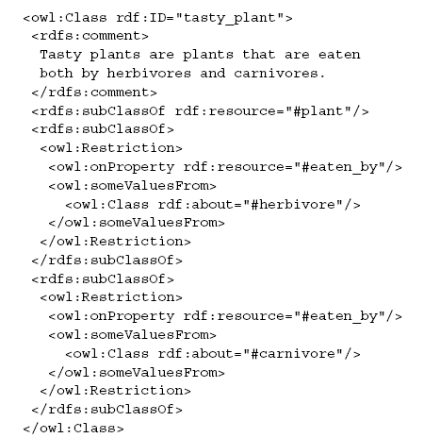
Tasty_plant = plant ∏ ∃ eaten_by.herbivore ∏ ∃ eaten_by.carnivore)

Slide 11
Omnivore are animals that eats some animal and plants ????
Vegetarian humans are those animals which eats only plants???

